Slide 1
Data Analysis and Visualization
Group 2: Airline Passenger Satisfaction
Anqi Xue (ax2170), Tanisha Aggrawal (ta2709), Vishal Bhardwaj (vb2573)

Slide 2
Initial data exploration
22 features
4 continuous numerical features: Age, Flight Distance, Departure Delay in Minutes, Arrival Delay in Minutes
4 categorical features with String values: Gender, Customer Type, Type of Travel, Class
14 categorical features with ordinal values
1 target variable: satisfaction
Dev Set
103904 samples
310 samples contained null values. Corresponding samples were dropped.
Test Set
25976 samples
83 samples contained null values. Corresponding samples were dropped.
Link
https://www.kaggle.com/datasets/teejmahal20/airline-passenger-satisfaction

Slide 3
2. Cleaning and sampling
Data Preprocessing Steps:
Load the datasets
Read the two csv files and save the data into dev_df and test_df
Missing values analysis
Remove the information about the passenger (the whole row) if part of their data is missing
Explain the distribution of the target variable and the dataset
‘satisfied’ : ‘neutral or dissatisfied’ = 0.43 : 0.57, slightly imbalanced
Drop the columns
Drop the columns 'id' and 'satisfaction' for both X_dev and X_test
Exploratory Data Analysis
Encode the 4 categorical features with String values using Ordinal Encoding
Scale the dataset using StandardScaler()

Slide 4
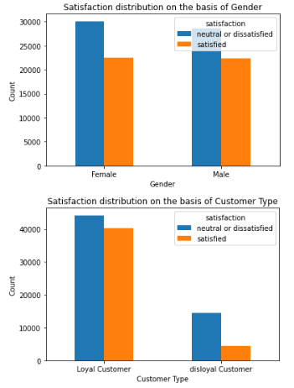
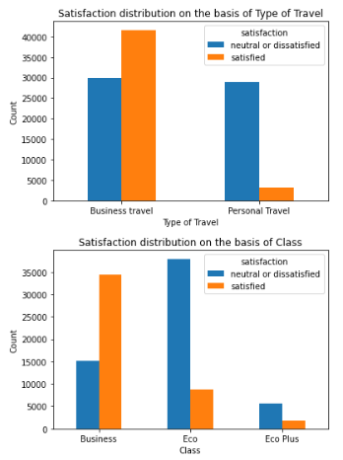
3. Insights from data exploration
Categorical Features Analysis
Similar distribution of target variable in each category for the features Gender and Customer Type.
Similar number of ‘Males’ and ‘Females’ in the Dev set.
Almost 4.5 times more loyal customers than disloyal customers.
Number of dissatisfied customers is similar for customers travelling for business and personal purposes.
58% customers travelling for business purposes are satisfied whereas only 10% of customers travelling for personal purposes are satisfied.
Only 2940 more customers travelled in Business than Eco.
69.5% customers travelling in Business class were satisfied whereas only 18.6% customers travelling in Eco class were satisfied.
Only 7.2% customers travelled in Eco Plus.

Slide 5
3. Insights from data exploration
Categorical Features Analysis (Ordinal Values)
It is highly likely customers were dissatisfied with the overall experience if they rated 3 or less on these features EXCEPT:
Gate Location
Departure/Arrival time convenient
Food and Drink
Highly likely customers were satisfied with the overall experience if they rated 5 on the following features:
Inflight Wifi service
Ease of Online Booking
Online Boarding
The number of dissatisfied customers for any rating is always more than the satisfied customers for the feature Departure/Arrival time convenient.
General trend of increasing or similar number of satisfied customers with increase in rating value for any feature.

Slide 6
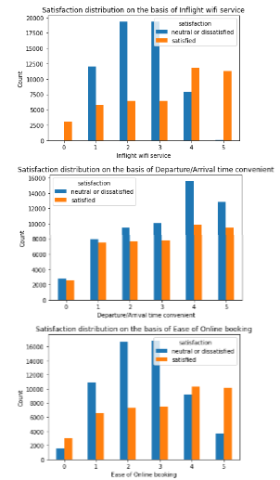
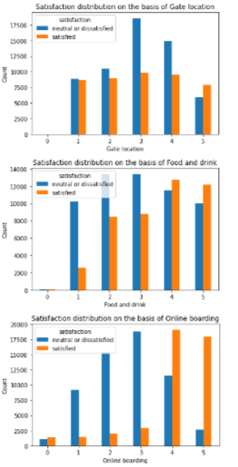
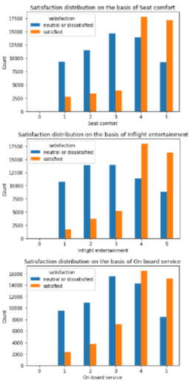
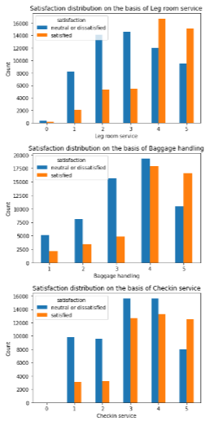
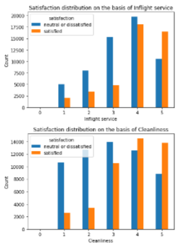
3. Insights from data exploration
Categorical Features Analysis (Ordinal Values)

Slide 7
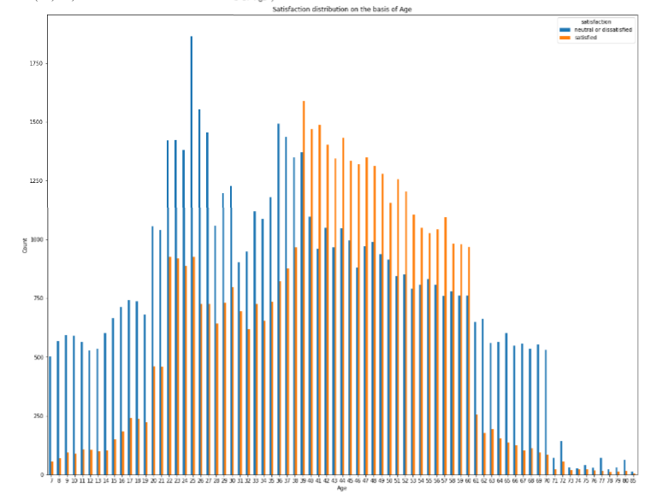
3. Insights from data exploration
Continuous Features Analysis: Age
Number of satisfied customers is consistently more than neutral or dissatisfied customers in the age group 39-60.
The number of neutral or dissatisfied customers in the age group 7-38 and 61-85 significantly exceeds the number of satisfied customers.

Slide 8
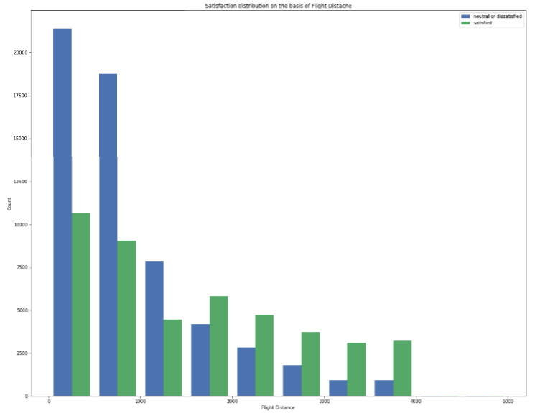
3. Insights from data exploration
Continuous Features Analysis: Flight Distance
69.7% customers in the survey travelled less than 1500 miles.
Two-thirds of the customers travelling less than 1500 miles were neutral or dissatisfied.
Amongst customers who travelled more than 1500 miles, the number of satisfied customers is twice as many as dissatisfied customers.
The number of customers who travelled more than 4000 miles is just 58, which is ~0.056% of the total sample size.

Slide 9
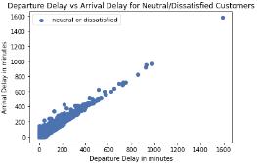
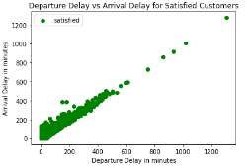
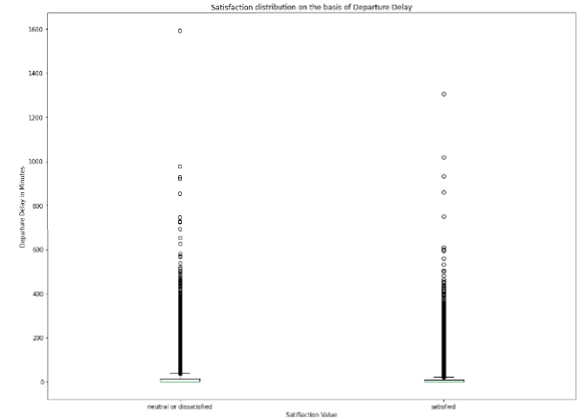
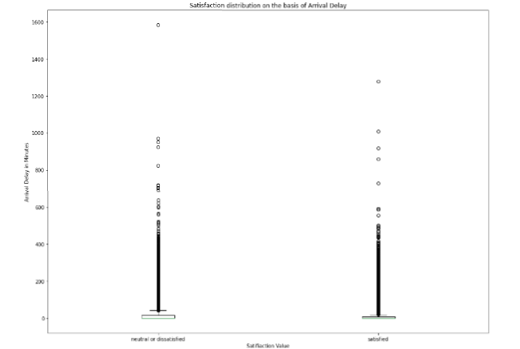
3. Insights from data exploration
Continuous Features Analysis: Departure Delay and Arrival Delay
Highly skewed with no clear pattern with respect to target variable.
Departure delay: first quartile = 0.00 ; third quartile = 12.00
Arrival delay: first quartile = 0.00 ; third quartile = 13.00
Highly correlated features with value of 0.965.

Slide 10
4. Machine Learning techniques proposed to be implemented
Logistic Regression
sklearn.linear_model.LogisticRegressionCV
penalty = ‘l2’
Cs : {0.1, 1.0, 10.0, 100.0, 1000.0}
cv = 5
Random Forest
sklearn.ensemble.RandomForestClassifier
n_estimators : {30, 60, 90, 120, 150}
max_features : {'sqrt', 'log2', 0.3, 0.6, 0.9}
sklearn.model_selection.GridSearchCV
cv = 3
XGBoost
xgboost.XGBClassifier
learning_rate : {0.001, 0.01, 0.1, 1}
max_depth : {6, 9, 12, 15}
n_estimators : {50,100,150}
sklearn.model_selection.GridSearchCV
cv = 3

Slide 11
Thank You!

